Slide 1

Development of a Monte Carlo algorithm for optimal control problems
Semester thesis by Stefano Weidmann,
supervised by Prof. Patrick Jenny, Taha Koltukluoglu and Prof. Ralf Hiptmair
Based on Q. Wang et al. «A Monte Carlo method for solving unsteady adjoint equations», J. Comput. Phys. 227 (2008)

Slide 2
What?

Slide 3
Measurements

Slide 4
Optimal control

Slide 5
Optimal control discretized

Slide 6
Optimal control discretized

Slide 7
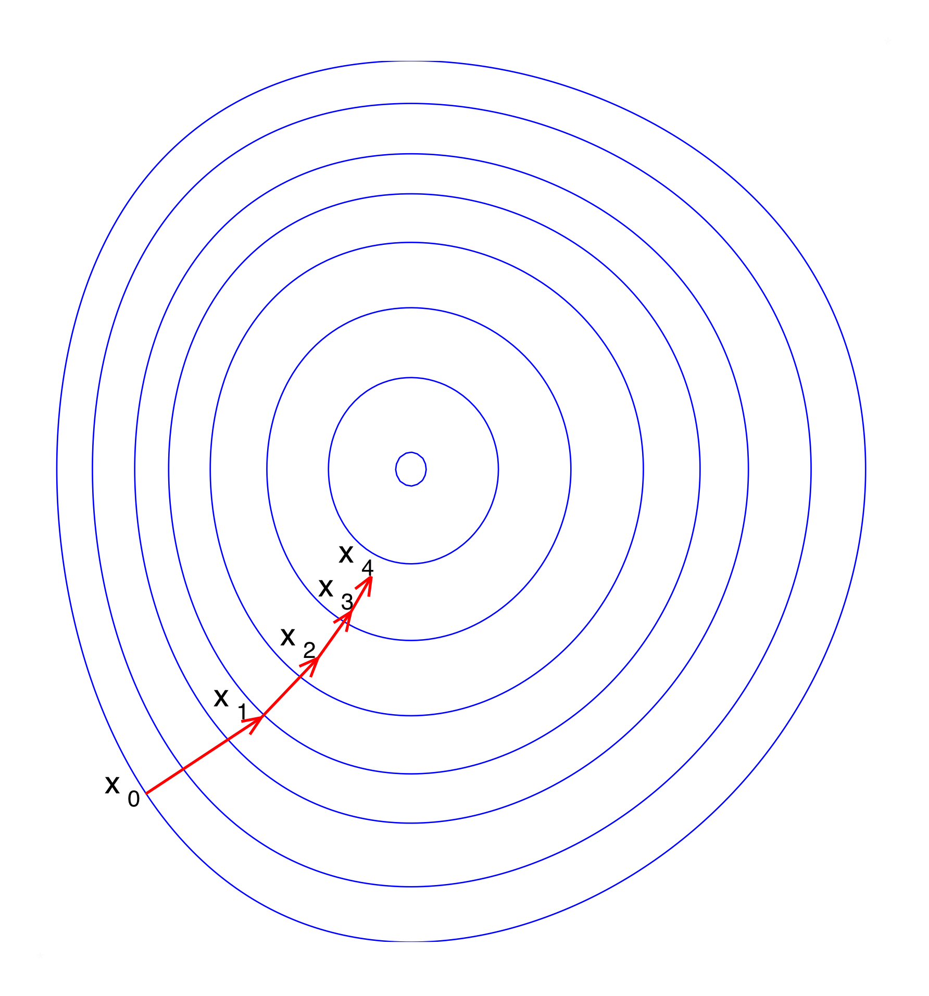
Goal
Image in public domain: https://commons.wikimedia.org/wiki/File:Gradient_descent.svg

Slide 8

Chain image from Chain by Adrien Coquet from the Noun Project CC0

Slide 9
Chain image from Chain by Adrien Coquet from the Noun Project CC0

Slide 10
Adjoint

Slide 11
Adjoint

Slide 12
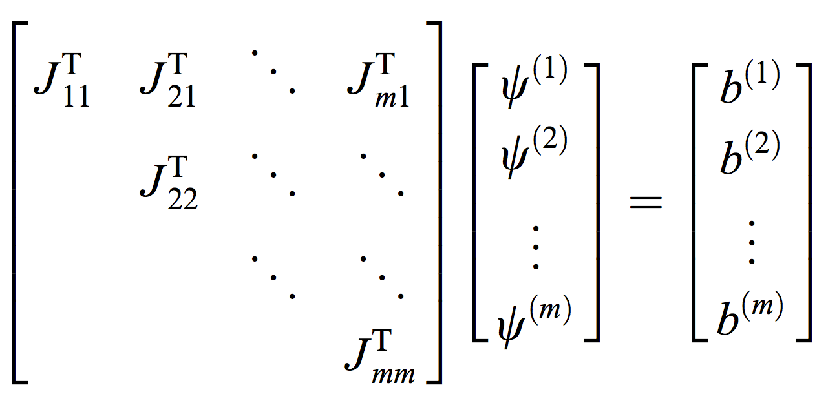
Adjoint
Linear system of equation included from main paper (see title slide)

Slide 13
Adjoint
Linear system of equation included from main paper (see title slide)

Slide 14
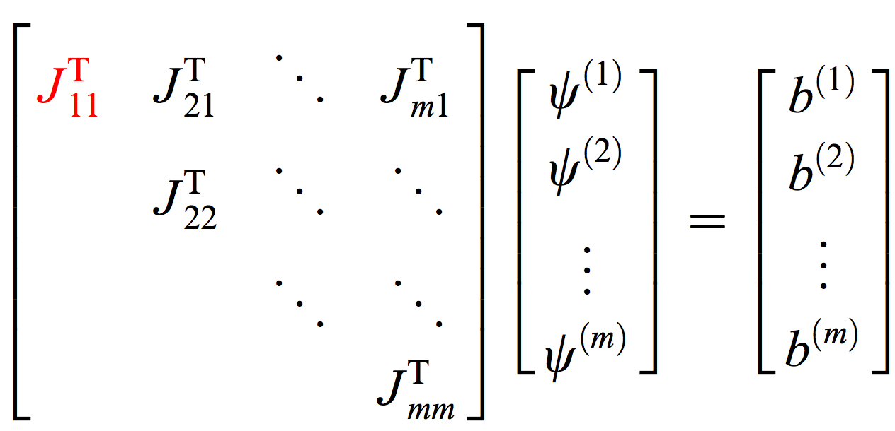
Adjoint
Linear system of equation included from main paper (see title slide)

Slide 15
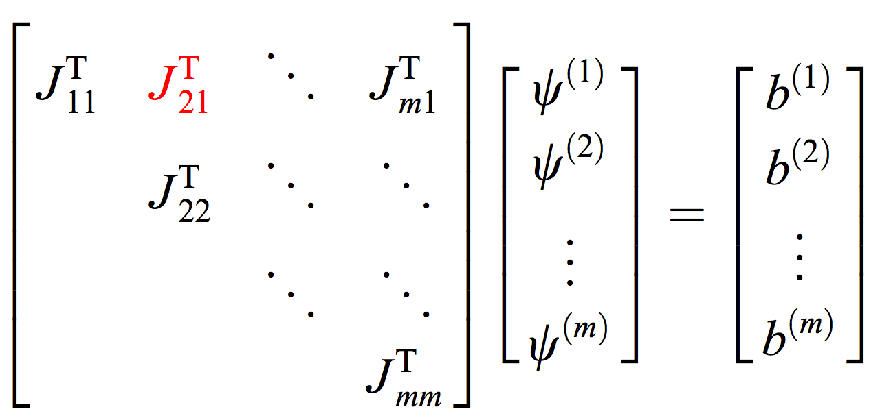
Adjoint
Linear system of equation included from main paper (see title slide)

Slide 16
Monte Carlo
Image in public domain: https://commons.wikimedia.org/wiki/File:Gradient_descent.svg

Slide 17
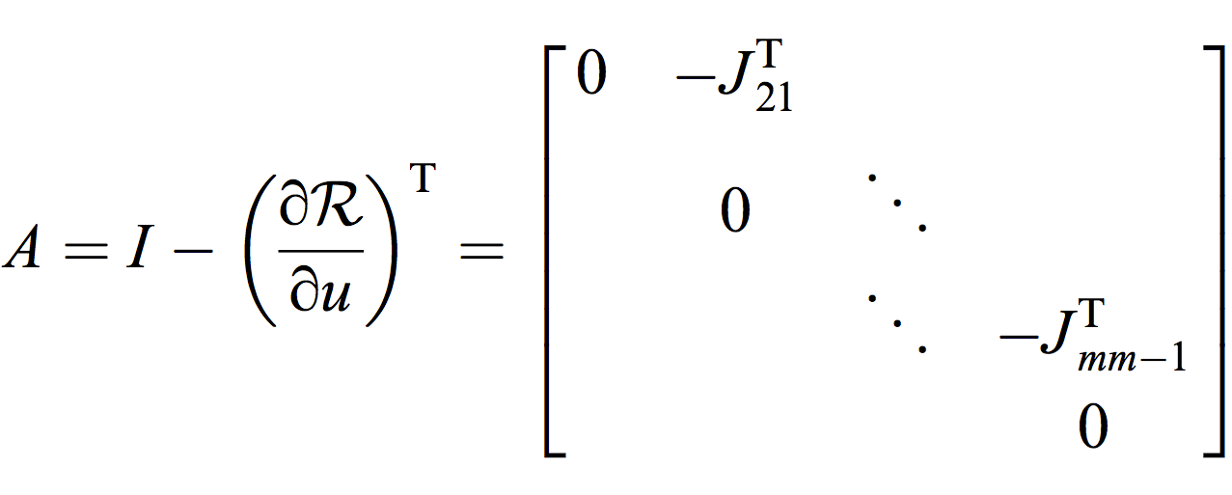
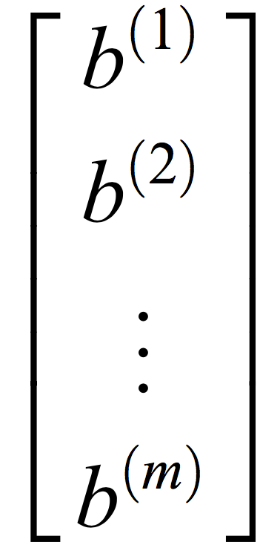
Monte Carlo
Formulas from the main paper (see title slide)

Slide 18
Monte Carlo

Slide 19
Monte Carlo

Slide 20
Monte Carlo

Slide 21
Monte Carlo

Slide 22
Monte Carlo

Slide 23
Monte Carlo

Slide 24
Monte Carlo

Slide 25
Test drive

Slide 26
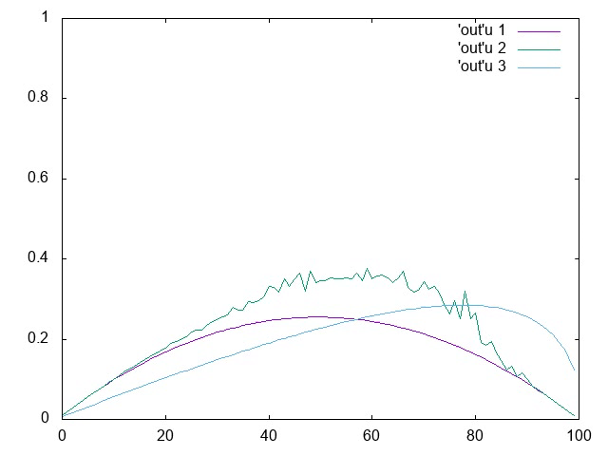
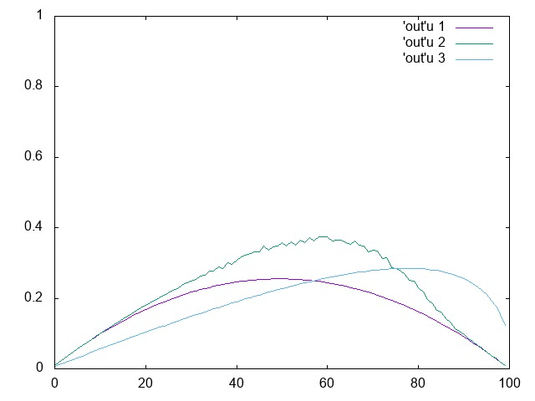
Test drive

Slide 27


History matching
Drill image created by BomSymbols for the Noun project, oil rig created by Gabriele Malaspina for the Noun project

Slide 28
History matching
Drill image created by BomSymbols for the Noun project, oil rig created by Gabriele Malaspina for the Noun project

Slide 29
History matching

Slide 30
Adjoint comparison for pressures

Slide 31
Adjoint comparison for saturations

Slide 32
Why?
Bi than 1..
5.3. Growth of variance
„As the random walk proceeds through time steps, the variance can suffer from exponential growth if the multiplicative factor
is greater than 1.
If this is the case, the probable error can be too large for our Monte Carlo method to be practical. On
the other hand, if this factor is less or equal to 1, the variance grows at most linearly. For this reason, the size of multiplicative factor is critical in the efficiency of our Monte Carlo method.“

Slide 33
Why?
[2018-05-27 16:38:33.993] [logger] [info] Finished adding 10 random walks
[2018-05-27 16:38:33.993] [logger] [info] Sum of probs = 1.49996, isAPressure = false
[2018-05-27 16:38:33.993] [logger] [info] Sum of probs = 0.00484627, isAPressure = true
[2018-05-27 16:38:33.993] [logger] [info] Sum of probs = 17.4986, isAPressure = false
[2018-05-27 16:38:33.993] [logger] [info] Sum of probs = 0.00484627, isAPressure = true
[2018-05-27 16:38:33.993] [logger] [info] Sum of probs = 17.4986, isAPressure = false
[2018-05-27 16:38:33.993] [logger] [info] Sum of probs = 1.49996, isAPressure = false
[2018-05-27 16:38:33.993] [logger] [info] Sum of probs = 1.49996, isAPressure = false
[2018-05-27 16:38:33.993] [logger] [info] Sum of probs = 1.49996, isAPressure = false
[2018-05-27 16:38:33.993] [logger] [info] Sum of probs = 0.00198823, isAPressure = true

Slide 34
Preconditioner

Slide 35
My best try
[2018-05-27 15:26:32.576] [logger] [info] Pressure residuals norm = 1, sat water residuals norm = 1
[2018-05-27 15:26:32.576] [logger] [info] Sum of probs = 1.33333, isAPressure = false
[2018-05-27 15:26:32.576] [logger] [info] Sum of probs = 0.00198823, isAPressure = true
[2018-05-27 15:26:32.576] [logger] [info] Pressure residuals norm = 0.499964, sat water residuals norm = 1
[2018-05-27 15:26:32.576] [logger] [info] Sum of probs = 1.19999, isAPressure = false
[2018-05-27 15:26:32.576] [logger] [info] Sum of probs = 0.00198823, isAPressure = true
[2018-05-27 15:26:32.576] [logger] [info] Pressure residuals norm = 16.3515, sat water residuals norm = 1.14716
[2018-05-27 15:26:32.576] [logger] [info] Sum of probs = 1.89188, isAPressure = false
[2018-05-27 15:26:32.576] [logger] [info] Sum of probs = 0.000129327, isAPressure = true
[2018-05-27 15:26:32.577] [logger] [info] Pressure residuals norm = 0.619265, sat water residuals norm = 1
[2018-05-27 15:26:32.577] [logger] [info] Sum of probs = 1.23643, isAPressure = false
[2018-05-27 15:26:32.577] [logger] [info] Sum of probs = 0.0165911, isAPressure = true

Slide 36
Monte Carlo vs. traditional adjoint

Slide 37
Monte Carlo vs. traditional adjoint

Slide 38
So?
“In the context of partial differential equations, choosing a preconditioner that transforms the random walk into the frequency space is an ideal currently being investigated. Preliminary results (2008) show that this preconditioner may be a solution to certain problems on which achieving a bounded variance growth using existing preconditioners is difficult.”

